Slide 1
The Great New Zealand Pollinator Path
Launching 2023
Notes:
Kia ora everyone, my name is Andrea Reid and I am the founder of the charity Pollinator Paths and I’m here to talk to you about how we can collaborate to launch the Great NZ Pollinator Path in 2023.

Slide 2
“to create connected ecosystems across urban landscapes where pollinators can thrive”
- Pollinator Paths, Mission Statement
Notes:
Pollinator Paths is a New Zealand charity where our mission is to create connected ecosystems across urban landscapes where pollinators can thrive

Slide 3
“This will help inspire and support a clean and green future, full of locally sourced food, in which the people of Aotearoa can feel a real connection to the land”
- Pollinator Paths, Mission Statement
Notes:
This will help inspire and support a clean and green future, full of locally sourced food, in which the people of Aotearoa can feel a real connection to the land

Slide 4
Meet the New Zealand Pollinators
Notes:
Now I would like to introduce you to New Zealand’s special pollinators. When I talk about pollination, I’d like you to raise your hand if your first thought was this guy

Slide 5
Notes:
the honey bee

Slide 6
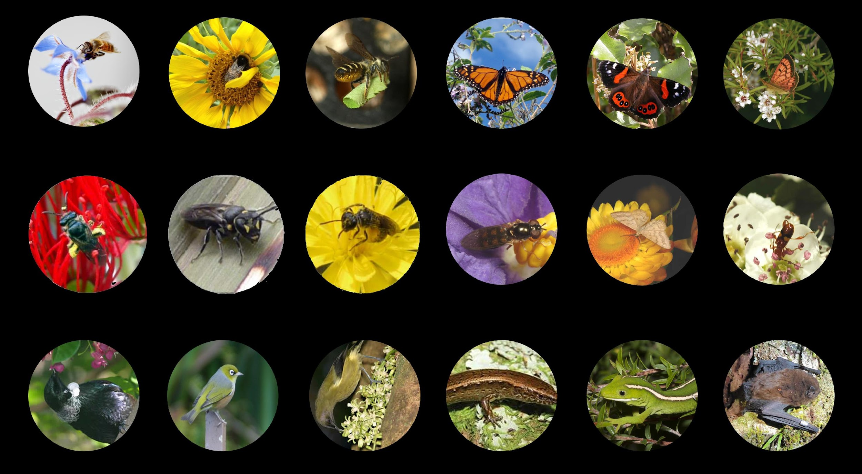
Honey bee
Bumble bee
Leafcutter bee
Monarch butterfly
Admiral butterfly
Copper butterfly
Hairy colletid
Masked bee
Sweat bee
Flies
Moths
Beetles
Tui
Wax eye
Bell bird
Copper skinks
Green gecko
Bats
Notes:
There are actually a range of pollinators in this country, including 30 different types of native bees. Unlike the honey bee, most of these are solitary and nest in ground.
There are also a range of:
birds
bats
lizards
skinks
butterflies
moths
flies
beetles
and other insects
that all pollinate the plants we need to survive

Slide 7
Pollinators are at threat from:
Loss of habitat e.g. nesting, food, water
Pesticides and herbicides
Predators e.g. mice and rats
Change in climate
Notes:
Unfortunately pollinators are at threat from many things, including:
Loss of habitat - including nesting, food, and water
Pesticides and herbicides
Predators -like mice and rats
and a change in climate

Slide 8
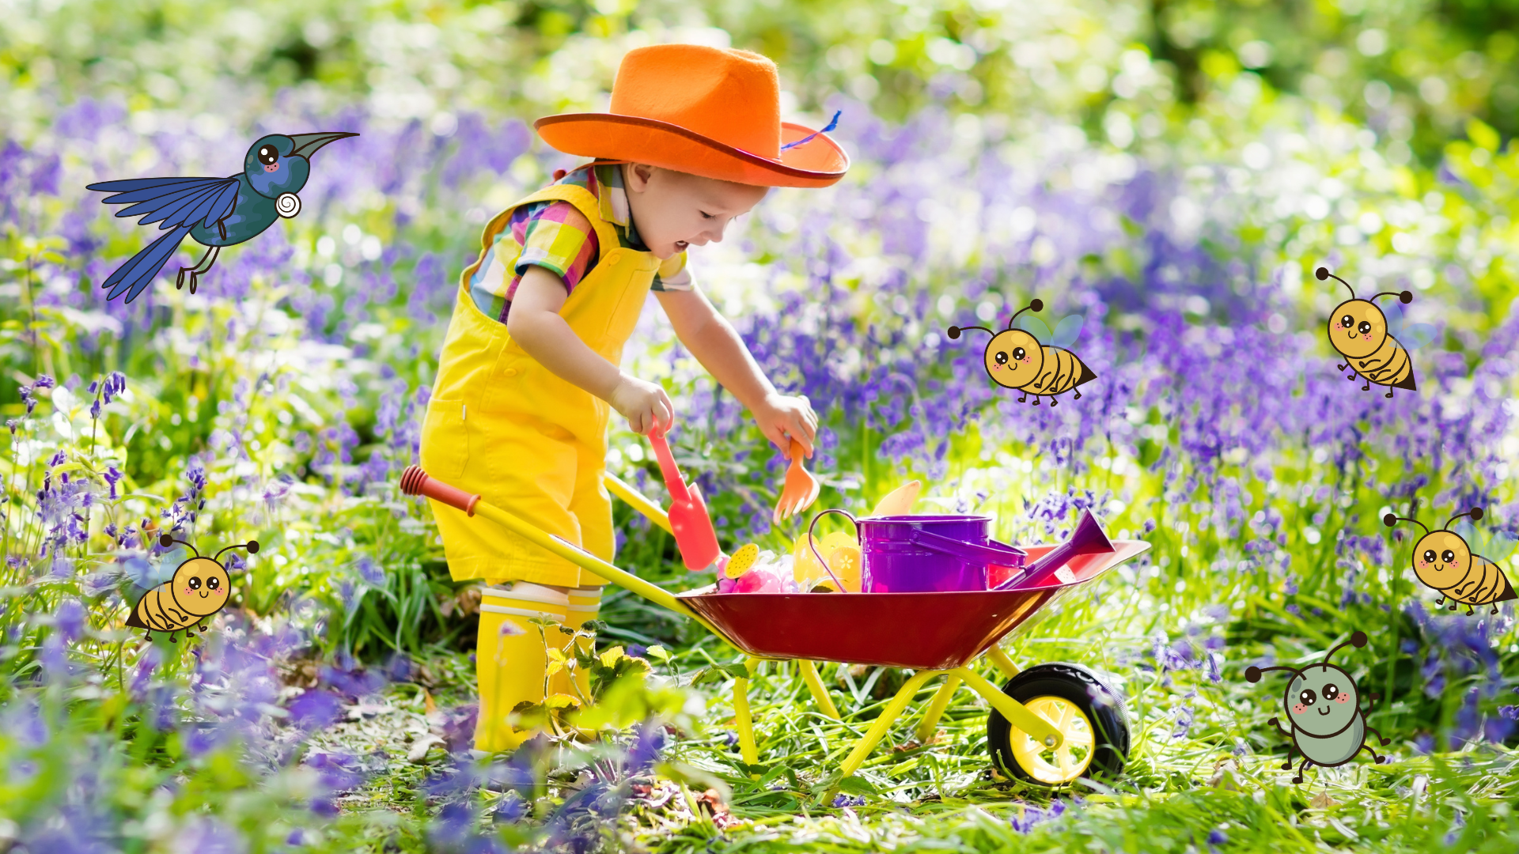
Notes:
Without pollinators many of our favourite plants and foods would not survive

Slide 9
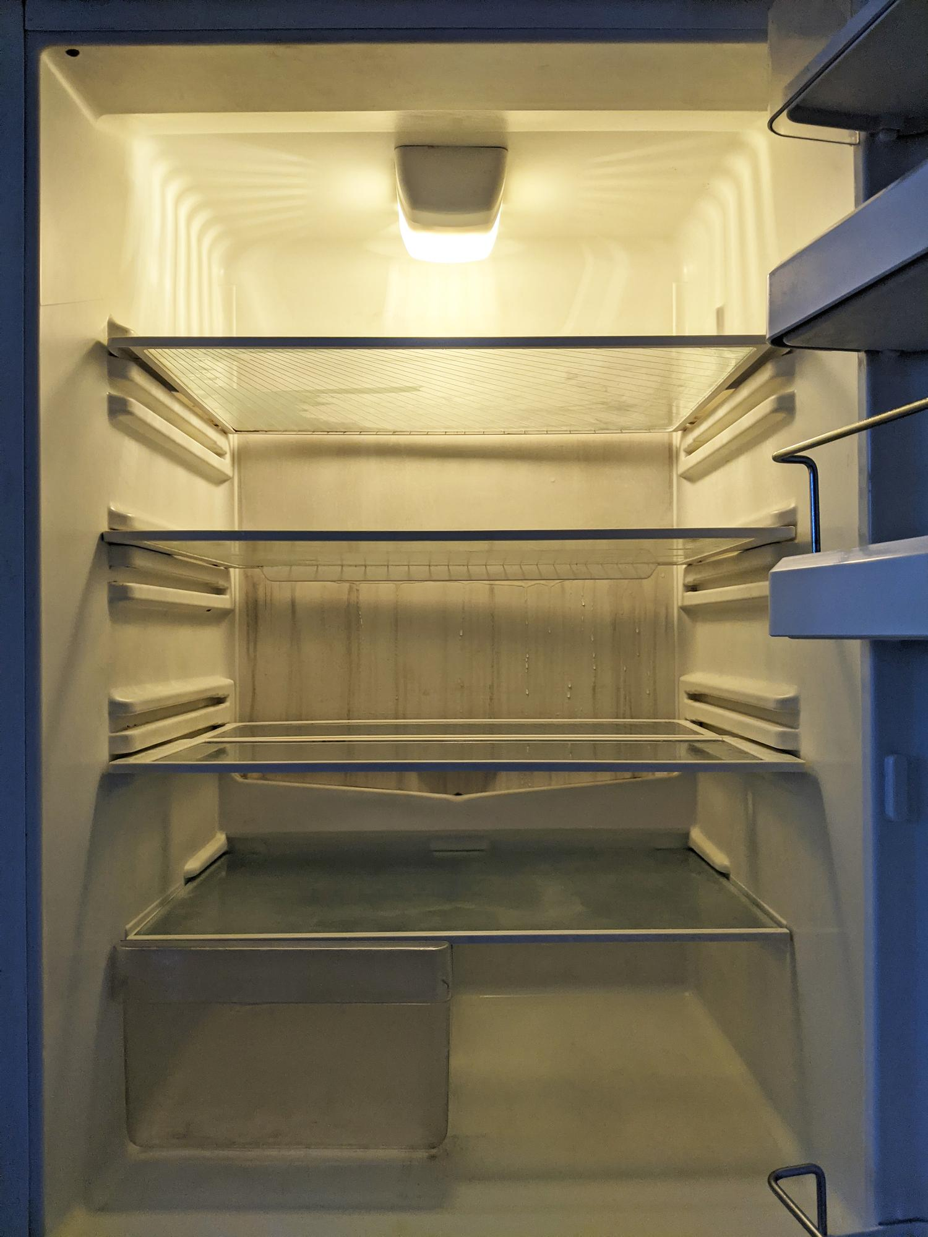
Every year, New Zealand produces enough food to feed 40 million people.
1 in 5 of us face food insecurity.
Notes:
Every year, New Zealand produces enough food to feed 40 million people.
1 in 5 of us face food insecurity.

Slide 10
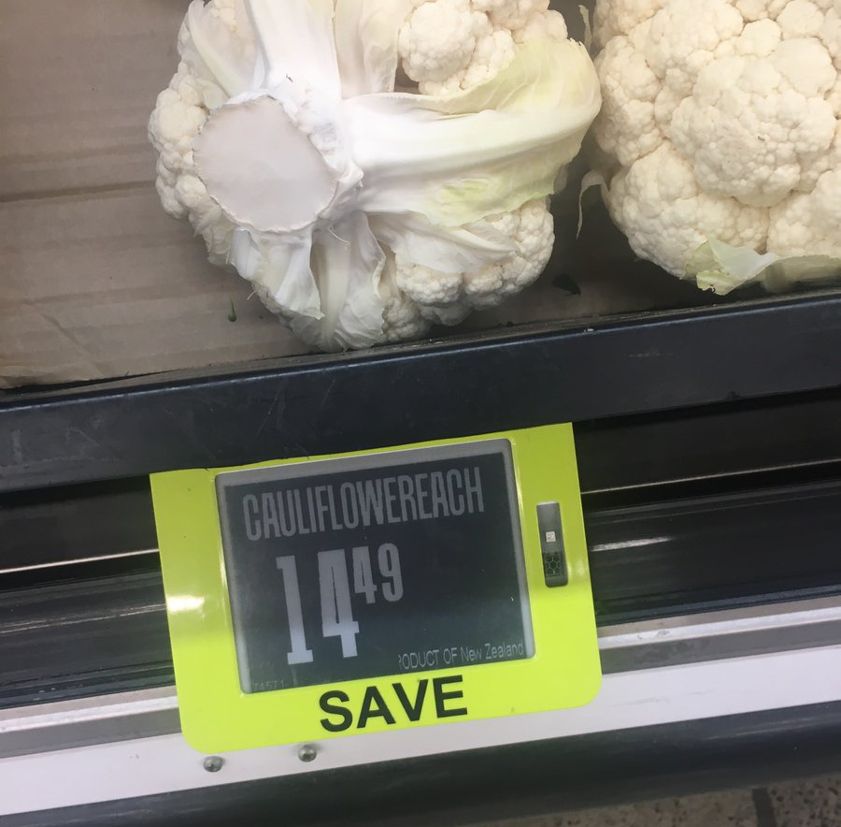
Notes:
It’s crazy that this is a thing now, the price of fresh food is getting out of hand, so it is more important than ever to create pollinator paths in urban areas to help pollinate our growing local food network and help people grow at home.

Slide 11
It will cover the length of the country. It will form slowly over 3-5 years as people take action, seeds grow, and pollinators find habitat. The New Zealand Pollinator Path will not be a physical line on a map but an observation of where life is thriving and adjust as life adjusts. The New Zealand Pollinator Path is about creating an intergenerational legacy for our environment and our people.
The Great New Zealand Pollinator Path 2023
Notes:
To help address these issues, we want to join with you to launch The Great New Zealand Pollinator Path in 2023.
It will cover the length of the country.
It will form slowly over 3-5 years as people take action, seeds grow, and pollinators find habitat.
The New Zealand Pollinator Path will not be a physical line on a map but an observation of where life is thriving and adjust as life adjusts.
The New Zealand Pollinator Path is about creating an intergenerational legacy for our environment and our people.

Slide 12
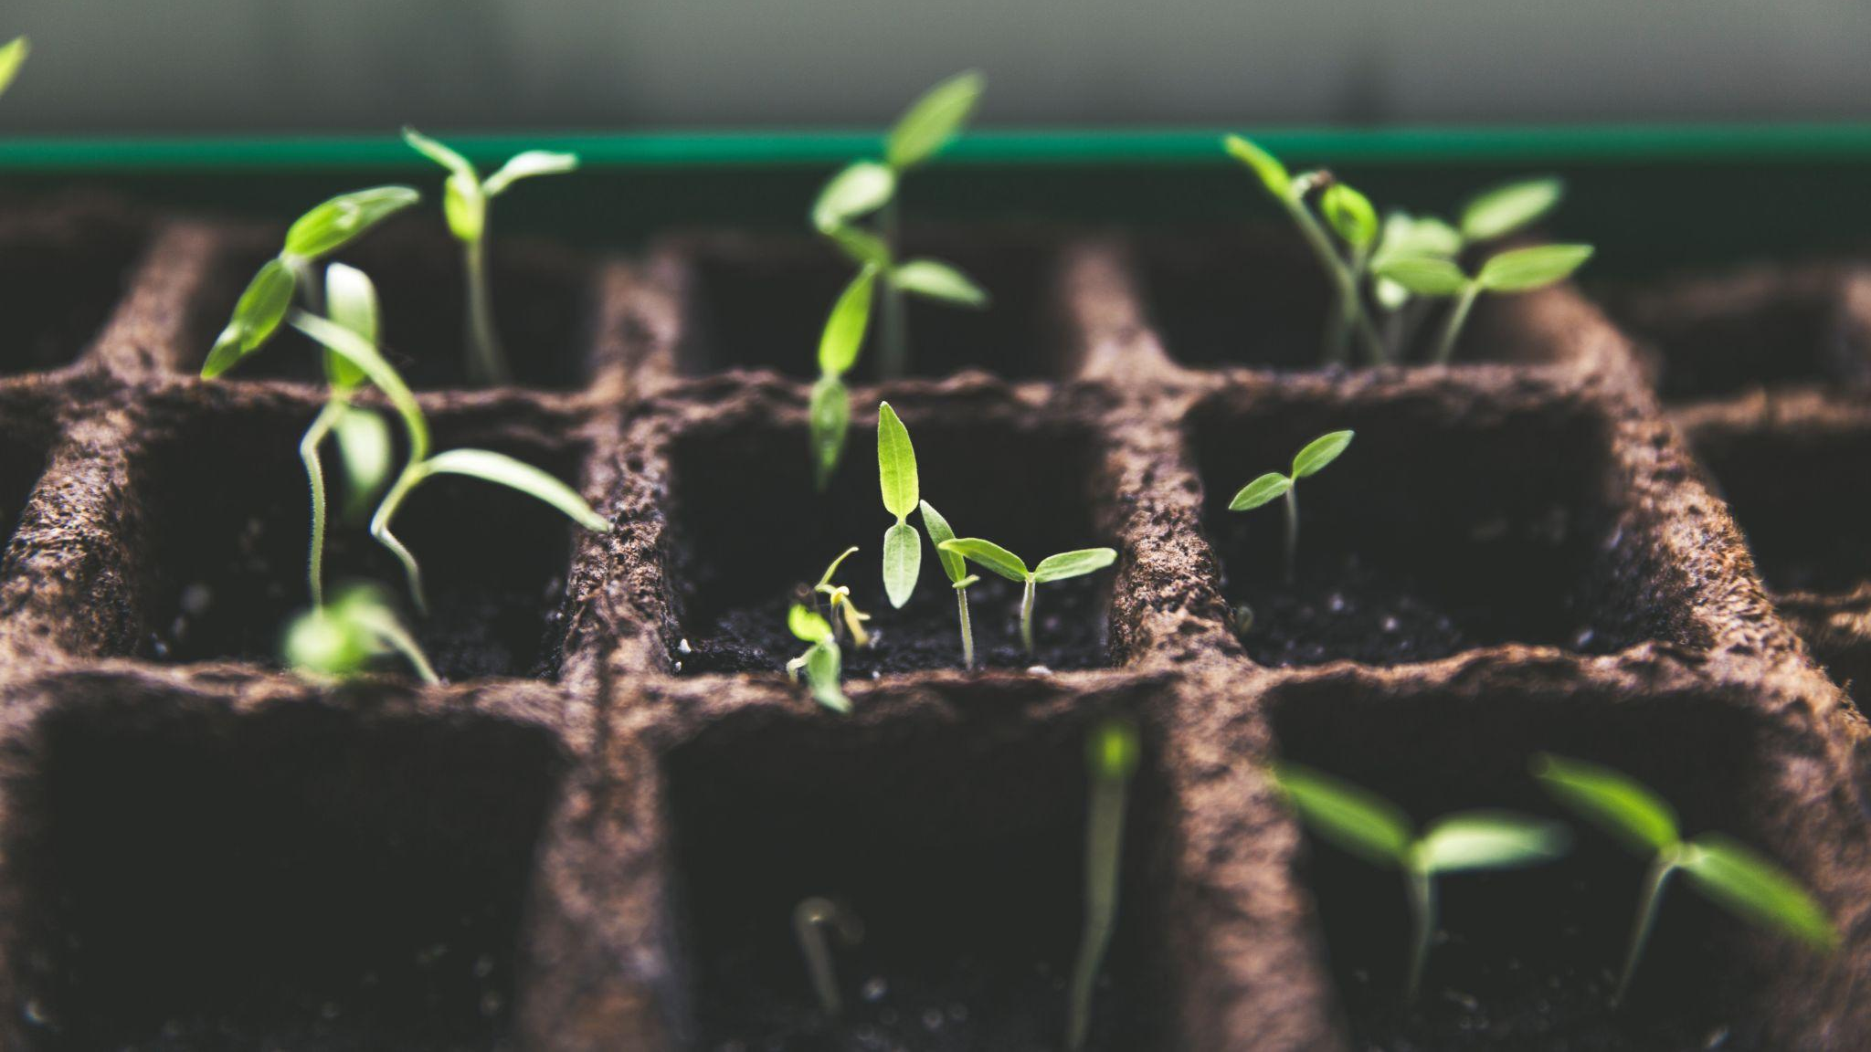
How will The New Zealand Pollinator Path be built? Everyone will have access to millions of seeds across New Zealand. This will include education and resource materials to help support eco-sourced seeds and germination. These seeds will be free to collect and can be planted on your property or in your neighborhood to build your path.
Notes:
So how will The New Zealand Pollinator Path be built?
Everyone will have access to millions of seeds across New Zealand.
This will include education and resource materials to help support eco-sourced seeds and germination.
These seeds will be free to collect and can be planted on your property or in your neighborhood to build your path.

Slide 13
What will The New Zealand Pollinator Path look like? Observe the pollinators in your neighborhood and log them on the iNaturalist App. Each pollinator has a unique area that forms their habitat.
Plant pollinator friendly plants and log them on our Growathon platform.
The more pollinators and plants observed the greater the Pollinator Path will form across the national network. The New Zealand Pollinator Path will be in real time on www.pollinatorpaths.com
Notes:
and what will The New Zealand Pollinator Path look like?
We will invite people to observe the pollinators in their neighborhood and log them on the iNaturalist App. Each pollinator has a unique area that forms their habitat.
We will also encourage people to plant pollinator friendly plants and log them on our Growathon platform.
The more pollinators and plants observed the greater the Pollinator Path will form across the national network.
The New Zealand Pollinator Path will be in real time on www.pollinatorpaths.com

Slide 14
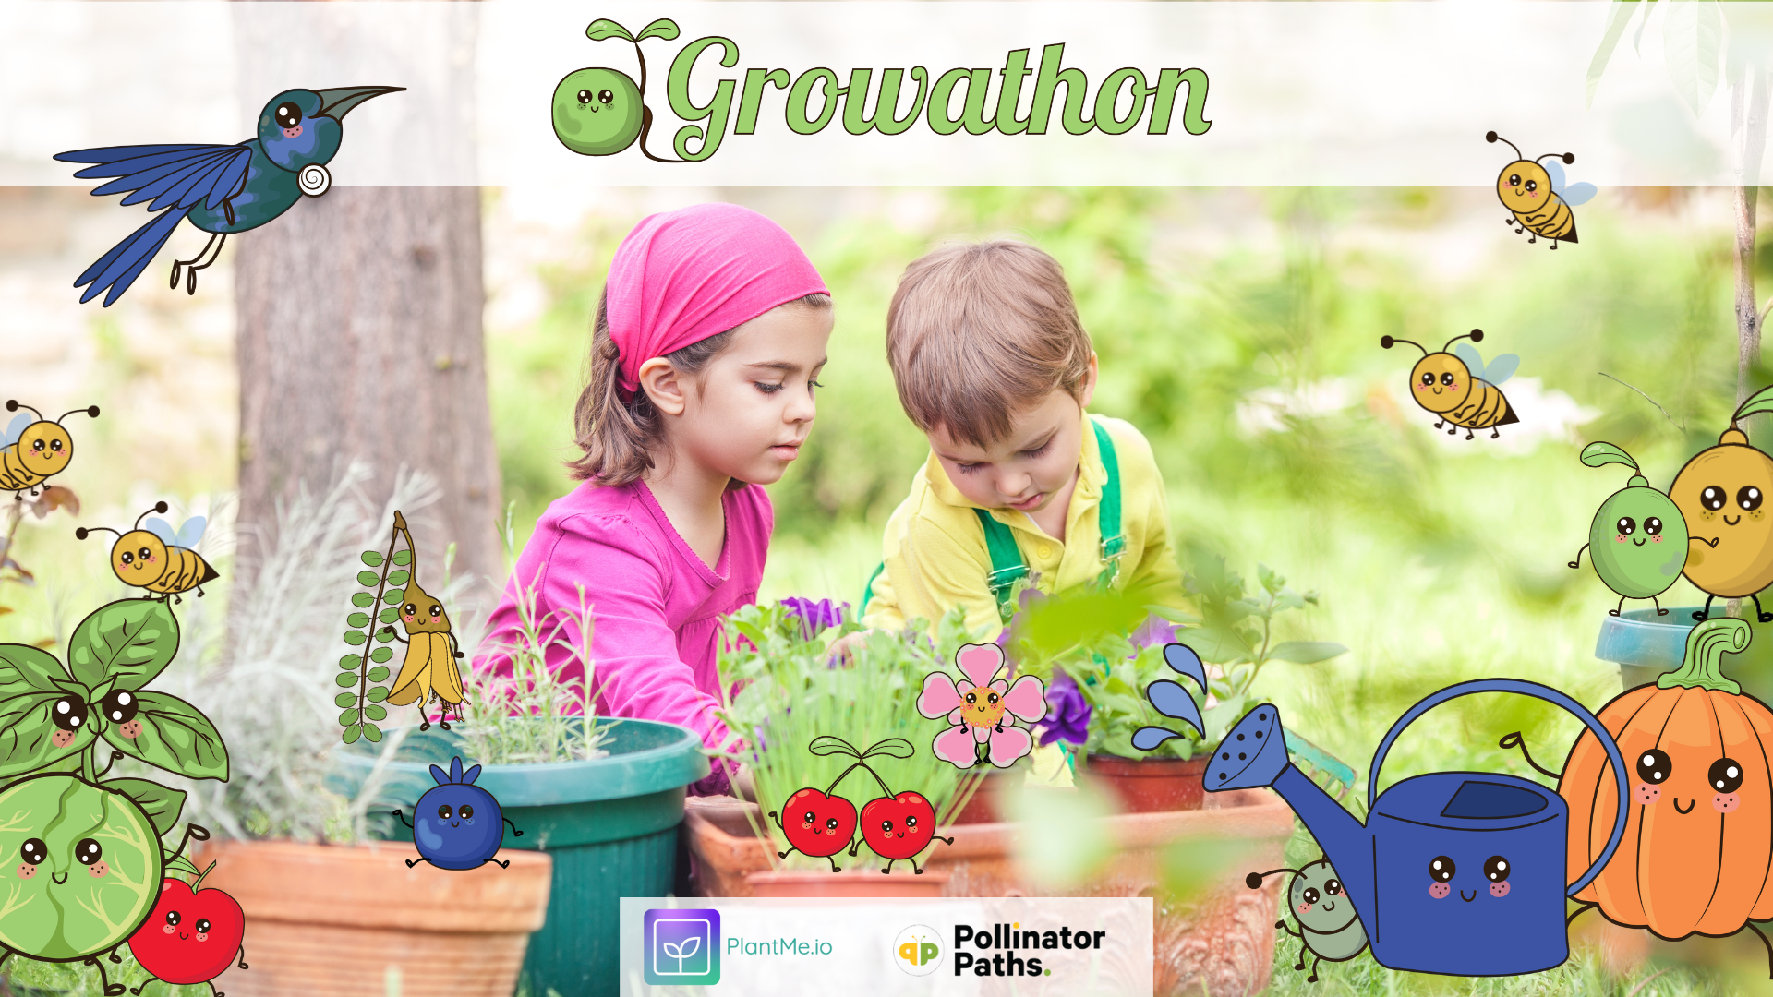
Notes:
Growathon is our existing platform that launches this spring in collaboration with PlantMe.io which allows users to log their plants, track what they are growing, measure their climate impact, and get rewarded for it. This platform will assist us with tracking all the pollinator friendly vegetation that people are planting and add it to our growing pollinator map.

Slide 15
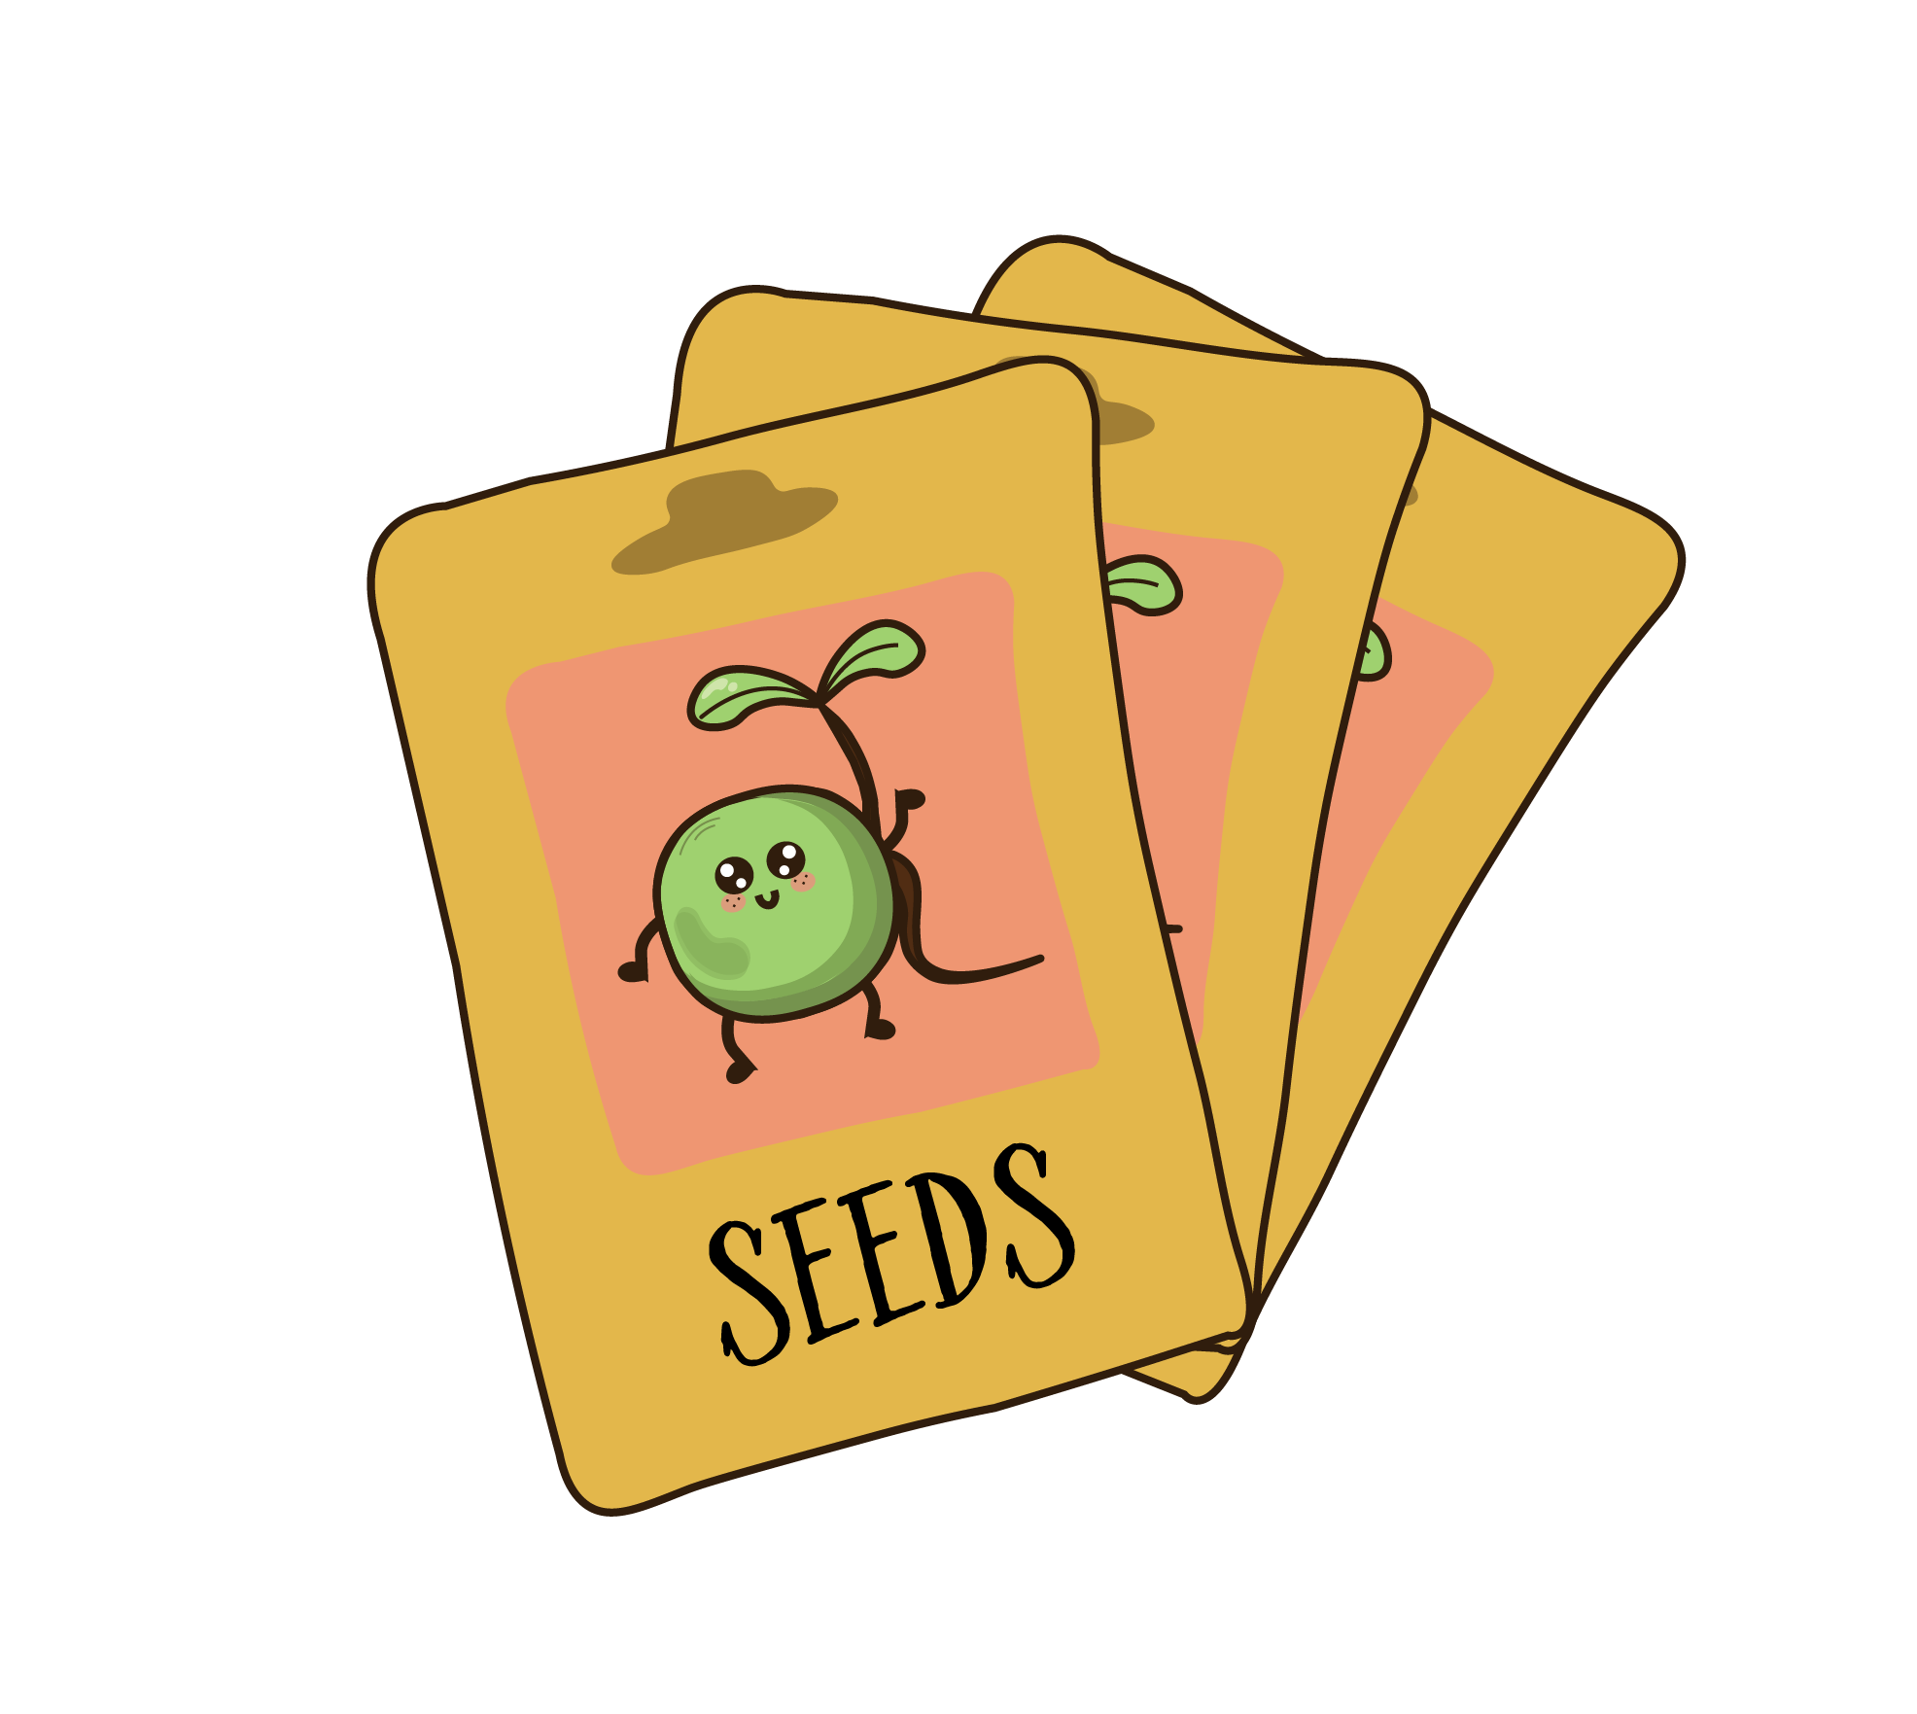
Take out seeds like you would take out a book!
The Story of Seeds
Notes:
And this is where the Public Libraries Network comes in, to help us tell the Story of Seeds.
One of the biggest barriers in our communities to starting a garden is the upfront cost, we want to remove that barrier for people by providing free seeds in every library and school across Aotearoa, so that people can take out a packet of seeds the same way they take out a book!
I know that this is already starting to happen, with seed banks in many libraries across the country, and we would love to help provide the tools and resources so that this can happen across all our libraries! We also want to help get the message out there that our libraries can help people to start their growing journey, with a national campaign.

Slide 16
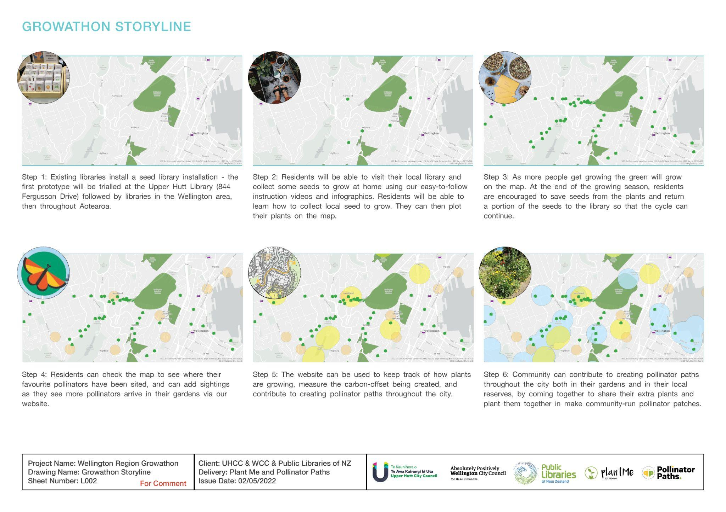
Grow your local Pollinator Path
STEP 1 : Library toolkit
STEP 2 : Collect seeds
STEP 3 : Watch the paths grow
STEP 4 : Spot the pollinators
STEP 5 : Return seeds to library
STEP 6 : Keep growing!
Notes:
So let’s talk about how it works.
Step 1: Libraries will be sent a toolkit to help them start their seedbank. It will include a range of seeds from our sponsors, a basic customisable display, a digital platform for seed distribution to be logged, and the tools needed for each library manager to continue sourcing local seeds for their seedbank.
Step 2: Local residents will be able to receive a free seed packet from their local library to start their seed growing journey.
Step 3: As residents get growing the green will start to grow on the live pollinator path map.
Step 4: Residents will be able to see the impact they are having, and watch as pollinator numbers start to grow in their communities.
Step 5: As the plants grow, the Growathon app will teach people how to collect the seed from their plants so that they can grow more plants, and return any extra seed to their library so that the circle of giving can continue.
Step 6: They will be encouraged to keep growing, trying out new seeds, and contributing any extra plants they grow to the formation of Pollinator Paths both with their neighbours, and at their local parks and schools.

Slide 17
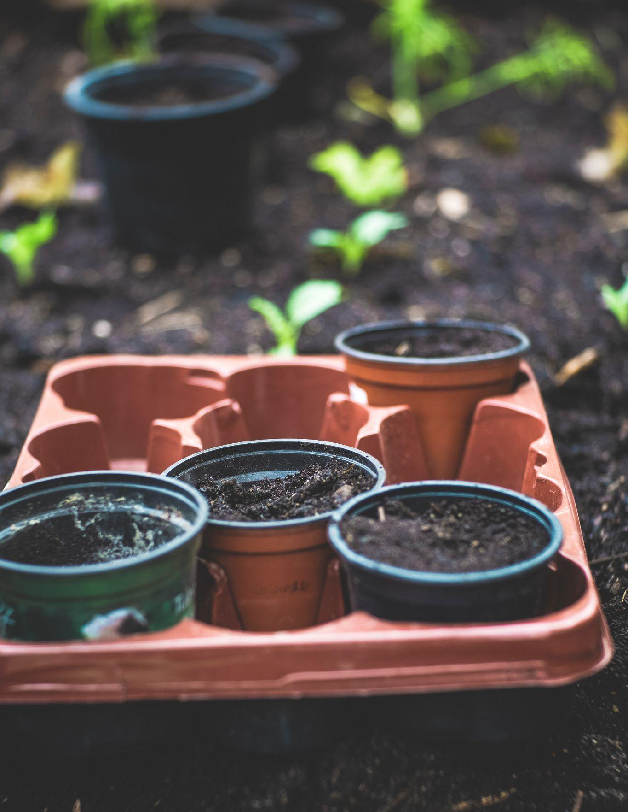
Testing a prototype The Pollinator Paths Charity and the PlantMe team have received funding from Upper Hutt City Council and Wellington City Council to undertake a 2022 Spring Growathon. The purpose of the Growathon is to keep people engaged with how to grow guides, tailored to location and time of year, plus a Planting Diary tracking their success, harvests, biodiversity milestones and climate impact.
As part of the programme we will work with the Upper Hutt City library, the existing Food For Thought seed bank, and the local community to undertake a soft launch of The New Zealand Pollinator Path seed bank toolkit. Learnings from this will go towards the launch in 2023.
Notes:
Our first step will be to test the prototype
The Pollinator Paths Charity and the PlantMe team have received funding from Upper Hutt City Council and Wellington City Council to undertake a 2022 Spring Growathon.
The purpose of the Growathon is to keep people engaged with how to grow guides, tailored to location and time of year, plus a Planting Diary tracking their success, harvests, biodiversity milestones and climate impact.
As part of the programme we will work with the Upper Hutt City library, the existing Food For Thought seed bank, and the local community to undertake a soft launch of The New Zealand Pollinator Path seed bank toolkit.
Learnings from this will go towards the launch in 2023.

Slide 18
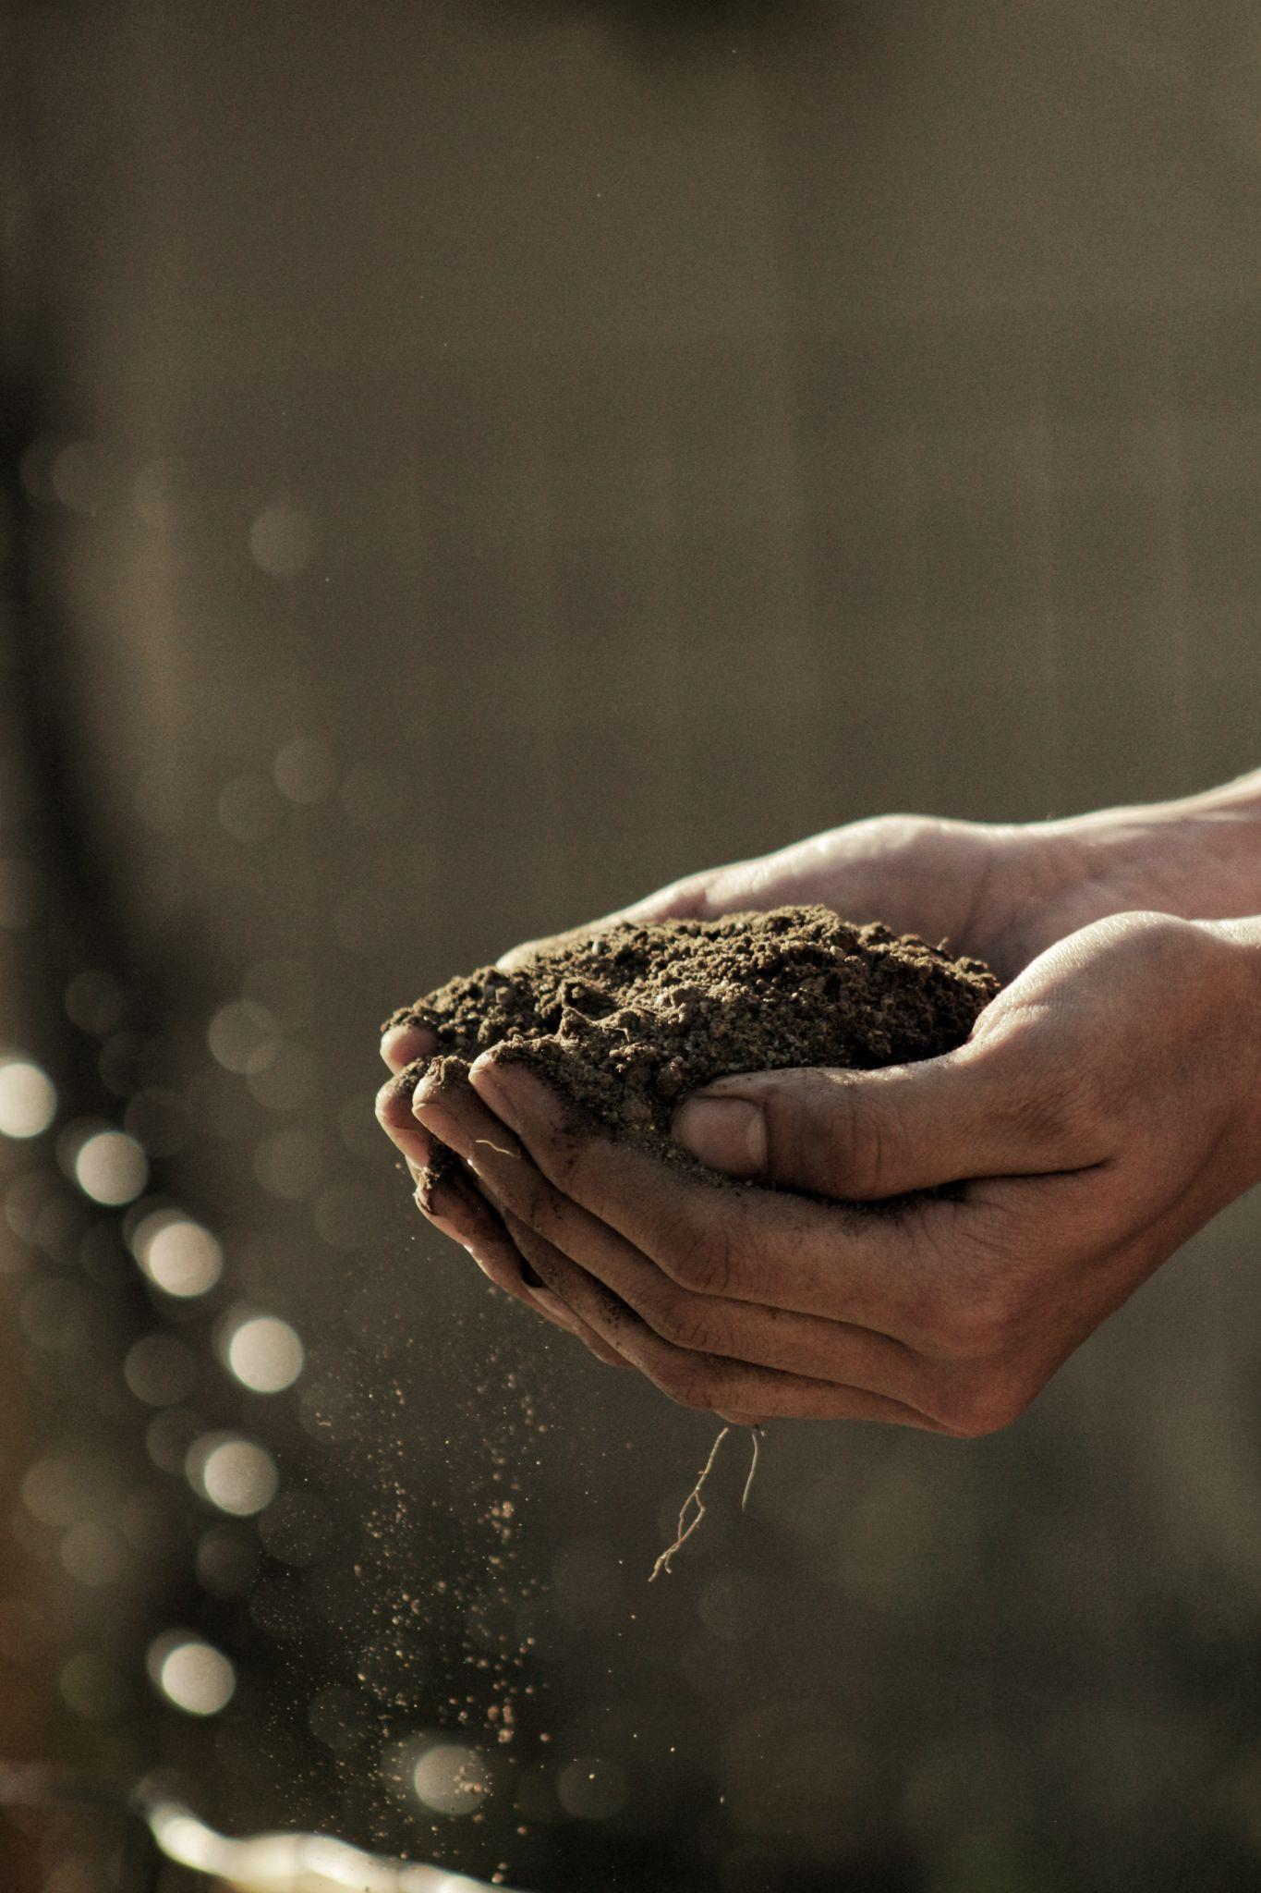
What assistance is needed? Pollinator Paths and PlantMe already have access to resources to build the live pollinator path and integrate with iNaturalist data. Plus the ability to create educational resources on pollinators and gathering seed.
We are also currently talking to several large sponsors who can assist us with funding the initial supply of seeds and distribution over the next three years. We would love to collaborate with the Public Libraries Network to work with us to test the prototype, host the seed hubs, tell the story of seeds, connecting with local communities to collect seed, and support a national communications campaign next year.
Notes:
So what assistance is needed?
Pollinator Paths and PlantMe already have access to resources to build the live pollinator path and integrate with iNaturalist data. Plus the ability to create educational resources on pollinators and gathering seed.
We are also currently talking to several large sponsors who can assist us with funding the initial supply of seeds and distribution over the next three years.
We would love to collaborate with the Public Libraries Network to work with us to test the prototype, host the seed hubs, tell the story of seeds, connecting with local communities to collect seed, and support a national communications campaign next year.
The story of our seeds is really special, and we hope that you would like to come on the journey with us next year to help make a difference!

Slide 19
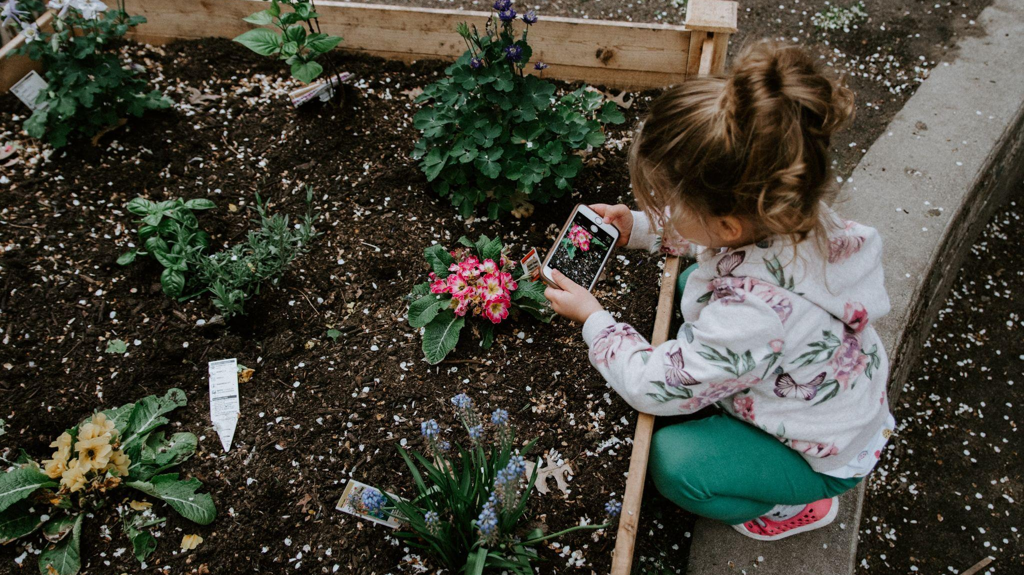
Questions?
Notes:
Now I’d like to open it up to the floor for feedback and to ask any questions.

